Slide 1

Object Oriented Programming through C++

Slide 2
INTRODUCTION
Developments in software technology continue to be dynamic.
New tools and techniques are announced in quick succession.
This has forced the software engineers and
industry to continuously look for new approaches to software design and development.
The following issued need to be addressed to face the crisis:

Slide 3
INTRODUCTION
How to represent real-life entities of problems in system design?
How to design system with open interfaces?
How to ensure reusability and extensibility of modules?
How to develop modules that are tolerant of any changes in future?
How to improve software productivity and decrease software cost?
How to improve the quality of software?
How to manage time schedules?

Slide 4
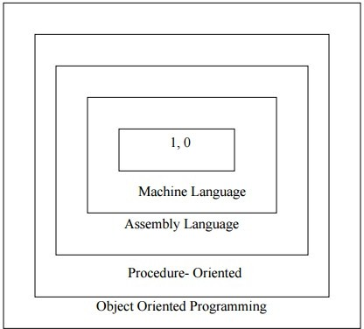
Software Evaluation

Slide 5
Software Evaluation
With the advent of languages such as c, structured programming became very popular and was the main technique of the 1980’s.
Structured programming was a powerful tool that enabled programmers to write moderately complex programs fairly easily.
However, as the programs grew larger, even the structured approach failed to show the desired result in terms of bug- free, easy-to- maintain, and reusable programs.

Slide 6
Software Evaluation
Object Oriented Programming (OOP) is an approach to program organization and development that attempts to eliminate some of the pitfalls of conventional programming methods by incorporating the best of structured programming features with several powerful new concepts.
It is a new way of organizing and developing programs and has nothing to do with any particular language.
However, not all languages are suitable to implement the OOP concepts easily.

Slide 7
Procedure-Oriented Programming
In the procedure oriented approach, the problem is viewed as the sequence of things to be done such as reading, calculating and printing such as COBOL, FORTRAN and C.
The primary focus is on functions.
A typical structure for procedural programming is shown in fig below.
The technique of hierarchical decomposition has been used to specify the tasks to be completed for solving a problem.

Slide 8
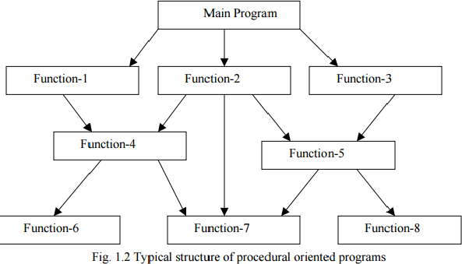
Procedure-Oriented Programming

Slide 9
Drawbacks of Procedure- Oriented Programming
Procedure oriented programming basically consists of writing a list of instructions for the computer to follow, and organizing these instructions into groups known as functions.
In a multi-function program, many important data items are placed as global so that they may be accessed by all the functions.
Each function may have its own local data. Global data are more vulnerable to an inadvertent change by a function.
In a large program it is very difficult to identify what data is used by which function.

Slide 10
Drawbacks of Procedure- Oriented Programming
In case we need to revise an external data structure, we also need to revise all functions that access the data.
This provides an opportunity for bugs to creep in.
The procedural approach is that we do not model real world problems very well.
This is because functions are action-oriented and do not really corresponding to the element of the problem.

Slide 11
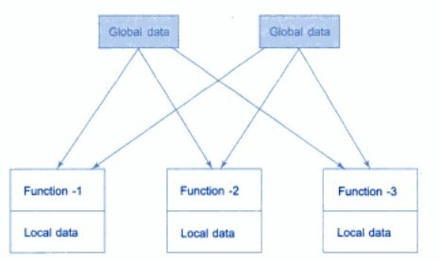
Relationship between Data and Functions

Slide 12
Advantages of Procedure- Oriented Programming
Some Characteristics exhibited by procedure-oriented programming are:
Emphasis is on doing things (algorithms).
Large programs are divided into smaller programs known as functions.
Most of the functions share global data.
Data move openly around the system from function to function.
Functions transform data from one form to another.
Employs top-down approach in program design.

Slide 13
Object Oriented Programming Paradigm
The major motivating factor in the invention of object- oriented approach is to remove some of the flaws encountered in the procedural approach.
OOP treats data as a critical element in the program development and does not allow it to flow freely around the system.
It ties data more closely to the function that operate on it, and protects it from accidental modification from outside function.

Slide 14
Object Oriented Programming Paradigm
OOP allows decomposition of a problem into a number of entities called objects and then builds data and function around these objects.
The organization of data and function in object-oriented programs is shown in fig.1.3.
The data of an object can be accessed only by the function associated with that object.
However, function of one object can access the function of other objects.

Slide 15
Object Oriented Programming Paradigm
Some of the features of object oriented programming are:
Emphasis is on data rather than procedure.
Programs are divided into what are known as objects.
Data structures are designed such that they characterize the objects.
Functions that operate on the data of an
object are ties together in the data structure.

Slide 16
Object Oriented Programming Paradigm
Data is hidden and cannot be accessed by external function.
Objects may communicate with each other through function.
New data and functions can be easily added whenever necessary.
Follows bottom up approach in program design.

Slide 17
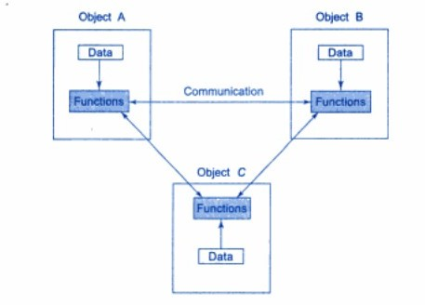
Object Oriented Programming Paradigm

Slide 18
Object Oriented Programming Paradigm
“Object oriented programming as an approach that provides a way of modularizing programs by creating partitioned memory area for both data and functions and that can be used as templates for creating copies of such modules on demand”.

Slide 19
Basic Concepts of Object Oriented Programming
It is necessary to understand some of the concepts used extensively in object-oriented programming. These include:
Objects
Classes
Data abstraction and encapsulation
Inheritance
Polymorphism
Dynamic binding
Message passing

Slide 20
Objects
Objects are the basic run time entities in an object-oriented system.
They may represent a person, a place, a bank account, a table of data or any item that the program has to handle.
They may also represent user-defined data such as vectors, time and lists.

Slide 21
Objects
Programming problem is analyzed in term of objects and the nature of communication between them.
Program objects should be chosen such that they match closely with the real-world objects.
Objects take up space in the memory and have an associated address like a record in Pascal, or a structure in c.

Slide 22
Objects
When a program is executed, the objects interact by sending messages to one another.
For example, if “customer” and “account” are two objects in a program,
then the customer object may send a message to the account object requesting for the bank balance.
Each object contain data, and code to manipulate data.

Slide 23
Objects
Objects can interact without having to know details of each other’s data or code.
It is a sufficient to know the type of message accepted, and the type of response returned by the objects.
Although different author represent them differently below figure shows two notations that are popularly used in object- oriented analysis and design.

Slide 24
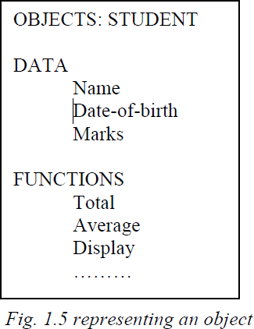
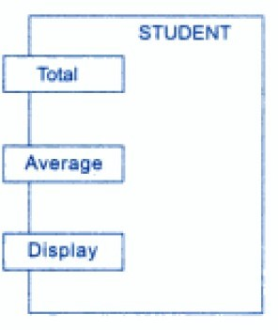
Objects

Slide 25
Classes
We just mentioned that objects contain data, and code to manipulate that data.
The entire set of data and code of an object can be made a user- defined data type with the help of class.
In fact, objects are variables of the type class.
Once a class has been defined, we can create any number of objects belonging to that class.
Each object is associated with the data of type class with which they are created.

Slide 26
Classes
A class is thus a collection of objects similar types.
For examples, Mango, Apple and orange members of class fruit.
Classes are user-defined that types and behave like the built-in types of a programming language.
The syntax used to create an object is not different then the syntax used to create an integer object in C.
If fruit has been defines as a class, then the statement
Fruit Mango;
Will create an object mango belonging to the class fruit.

Slide 27
Data Encapsulation
The wrapping up of data and function into a single unit (called class) is known as encapsulation.
Data and encapsulation is the most striking feature of a class.
The data is not accessible to the outside world, and only those functions which are wrapped in the class can access it.
These functions provide the interface between the object’s data and the program.
This insulation of the data from direct access by the program is called data hiding or information hiding

Slide 28
Data Abstraction
Abstraction refers to the act of representing essential features without including the background details or explanation.
Classes use the concept of abstraction and are defined as a list of abstract attributes such as size, wait, and cost, and function operate on these attributes.
They encapsulate all the essential properties of the object that are to be created.
The attributes are some time called data members because they hold information.
The functions that operate on these data are sometimes called methods or member function.
Classes known as abstract data types

Slide 29
Inheritance
Inheritance is the process by which objects of one class acquired the properties of objects of another classes.
It supports the concept of hierarchical classification
For example the bird, ‘robin’ is a part of class ‘flying bird’ which is again a part of the class ‘bird’.
The principal behind this sort of division is that each derived class shares common characteristics with the class from which it is derived as illustrated in fig 1.6.

Slide 30
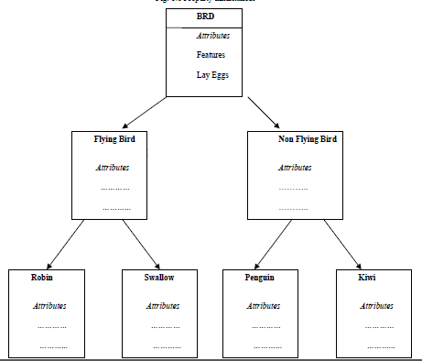
Inheritance

Slide 31
Inheritance
In OOP, the concept of inheritance provides the idea of reusability.
This means that we can add additional features to an existing class without modifying it.
This is possible by deriving a new class from the existing one.
The new class will have the combined feature of both the classes.
The real appeal and power of the inheritance mechanism is that it Allows the programmer to reuse a class i.e almost, but not exactly, what he wants, and to tailor the class in such a way that it does not introduced any undesirable side-effects into the rest of classes.

Slide 32
Polymorphism
Polymorphism is another important OOP concept.
Polymorphism, a Greek term, means the ability to take more than one form.
An operation may exhibit different behavior is different instances.
The behavior depends upon the types of data used in the operation.
For example, consider the operation of addition. For two numbers, the operation will generate a sum.
If the operands are strings, then the operation would produce a third string by concatenation.
The process of making an operator to exhibit different behaviors in different instances is known as operator overloading.

Slide 33
Polymorphism
Fig. 1.7 illustrates that a single function name can be used to handle different number and different types of argument.
This is something similar to a particular word having several different meanings depending upon the context.
Using a single function name to perform different type of task is known as function overloading.
Polymorphism is extensively used in implementing inheritance.

Slide 34
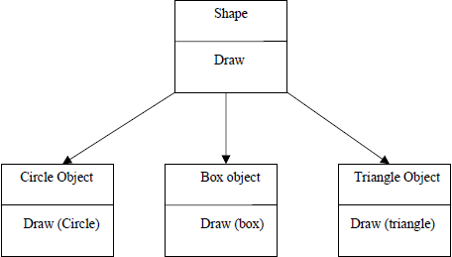
Polymorphism

Slide 35
Dynamic Binding
Binding refers to the linking of a procedure call to the code to be executed in response to the call.
Dynamic binding means that the code associated with a given procedure call is not known until the time of the call at run time.
It is associated with polymorphism and inheritance.
A function call associated with a polymorphic reference depends on the dynamic type of that reference.

Slide 36
Dynamic Binding
Consider the procedure “draw” in fig. 1.7. by inheritance, every object will have this procedure.
Its algorithm is, however, unique to each object and so the draw procedure will be redefined in each class that defines the object.
At run-time, the code matching the object under current reference will be called.

Slide 37
Message Passing
An object-oriented program consists of a set of objects that communicate with each other. The process of programming in an object-oriented language, involves the following basic steps:
1. Creating classes that define object and their behavior,
2. Creating objects from class definitions, and
3. Establishing communication among objects.

Slide 38
Message Passing
A Message for an object is a request for execution of a procedure, and therefore will invoke a function (procedure) in the receiving object that generates the desired results.
Object has a life cycle.
They can be created and destroyed. Communication with an object is feasible as long as it is alive.
Message passing involves specifying the name of object, the name of the function (message) and the information to be sent. Example:

Slide 39
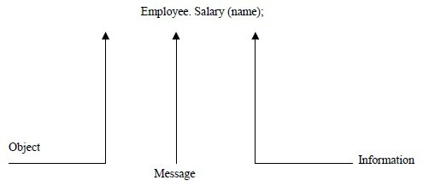
Message Passing

Slide 40
Benefits of OOP
Through inheritance, we can eliminate redundant code extend the use of existing classes.
We can build programs from the standard working modules that communicate with one another, rather than having to start writing the code from scratch. This leads to saving of development time and higher productivity.
The principle of data hiding helps the programmer to build secure program that can not be invaded by code in other parts of a programs.
It is possible to have multiple instances of an object to co-exist without any interference.
It is possible to map object in the problem domain to those in the program.

Slide 41
Benefits of OOP
It is easy to partition the work in a project based on objects.
The data-centered design approach enables us to capture more detail of a model can implemental form.
Object-oriented system can be easily upgraded from small to large system.
Message passing techniques for communication between objects makes to interface descriptions with external systems much simpler.
Software complexity can be easily managed.

Slide 42
Application of OOP
Real-time system
Simulation and modeling
Object-oriented data bases
Hypertext, Hypermedia, and expertext
AI and expert systems
Neural networks and parallel programming
Decision support and office automation systems
CIM/CAM/CAD systems

Slide 43
Introduction of C++
C++ is an object-oriented programming language.
It was developed by Bjarne Stroustrup at AT&T Bell Laboratories in Murray Hill, New Jersey, USA, in the early 1980’s.
Stroustrup, an admirer of Simula67 and a strong supporter of C, wanted to combine the best of both the languages and create a more powerful language that could support object-oriented programming features and still retain the power and elegance of C.
The result was C++.

Slide 44
Therefore, C++ is an extension of C with a major addition of the class construct feature of Simula67.
Since the class was a major addition to the original C language, Stroustrup initially called the new language ‘C with classes’.
However, later in 1983, the name was changed to C++. The idea of C++ comes from the C increment operator ++, thereby suggesting that C++ is an augmented version of C.

Slide 45
C+ + is a superset of C. Almost all c programs are also C++ programs. However, there are a few minor differences that will prevent a c program to run under C++ complier.
The most important facilities that C++ adds on to C care classes, inheritance, function overloading and operator overloading.
These features enable creating of abstract data types, inherit properties from existing data types and support polymorphism, thereby making C++ a truly object-oriented language.

Slide 46
Structure of C++ Program
A typical C++ program would contain four sections as shown in fig. 1.9.
This section may be placed in separate code files and then compiled independently or jointly.
It is a common practice to organize a program into three separate files.
The class declarations are placed in a header file and the definitions of member functions go into another file.

Slide 47
Structure of C++ Program
This approach enables the programmer to separate the abstract specification of the interface from the implementation details (member function definition).
Finally, the main program that uses the class is places in a third file which “includes: the previous two files as well as any other file

Slide 48
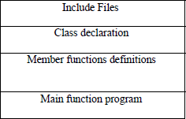
Structure of C++ Program

Slide 49
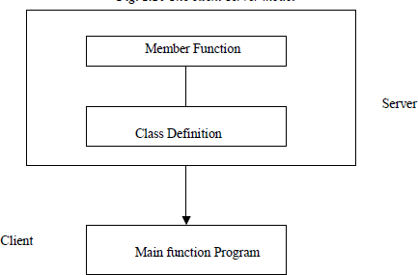
Structure of C++ Program

Slide 50
Structure of C++ Program
This approach is based on the concept of client-server model as shown in fig. 1.10.
The class definition including the member functions constitute the server that provides services to the main program known as client.
The client uses the server through

Slide 51
Creating, Compiling and Linking the Source File
vi, nano, ed editors used in unix environment.
Windows provides integrated environment.
Open new file and save the files.
Save the files .cpp extension.
For compilation in unix cc filename.cpp
In windows alt+f9
For execution in unix ./a.out

Slide 52
Simple C++ Program
Printing A String #include<iostream> Using namespace std; int main()
{
cout<<” c++ is better than c \n”; return 0;
}

Slide 53
Program feature
Like C, the C++ program is a collection of function.
The above example contain only one function
main().
As usual execution begins at main().
Every C++ program must have a main().
C++ is a free form language.
With a few exception, the compiler ignore carriage return and white spaces.
Like C, the C++ statements terminate with semicolons

Slide 54
Comments
The double slash comment is basically a single line comment. Multiline comments can be written as follows:
// This is an example of
// C++ program to illustrate
// some of its features
The C comment symbols /*,*/ are still valid and are more suitable for multiline comments. The following comment is allowed:
/* This is an example of C++ program to illustrate some of its features
*/

Slide 55
The iostream File
We have used the following #include directive in the program:
#include <iostream>
The #include directive instructs the compiler to include the contents of the file enclosed within angular brackets into the source file. The header file iostream.h should be included at the beginning of all programs that use input/output

Slide 56
Namespace
Namespace is a new concept introduced by the ANSI C++ standards committee.
This defines a scope for the identifiers that are used in a program.
For using the identifier defined in the namespace scope we must include the using directive, like
Using namespace std;
Here, std is the namespace where ANSI C++ standard class libraries are defined.
All ANSI C++ programs must include this directive. This will bring all the identifiers defined in std to the current global scope.
Using and namespace are the new keyword of C+
+.

Slide 57
Return Type of main()
In C++, main () returns an integer value to the operating system. Therefore, every main () in C++ should end with a return (0) statement; otherwise a warning an error might occur.
Since main () returns an integer type for main () is explicitly specified as int. Note that the default return type for all function in C++ is int.

Slide 58
Input Operator
The statement
cin >> number1;
Is an input statement and causes the program to wait for the user to type in a number.
The number keyed in is placed in the variable number1.
The identifier cin (pronounced ‘C in’) is a predefined object in C++ that corresponds to the standard input stream. Here, this stream represents the keyboard.

Slide 59
Input Operator
The operator >> is known as extraction or get from operator.
It extracts (or takes) the value from the keyboard and assigns it to the variable on its right fig 1.8.
This corresponds to a familiar scanf() operation. Like <<, the operator >> can also be overloaded.

Slide 60
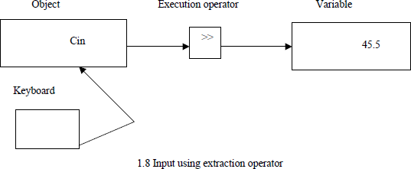
Input Operator

Slide 61
Output operator
The output statement is
Cout<<”C++ is better than C.”;
Causes the string in quotation marks to be displayed on the screen.
This statement introduces two new C++ features,
cout and <<. The identifier cout(pronounced as C out) is a predefined object that represents the standard output stream in C++.
Here, the standard output stream represents the screen. It is also possible to redirect the output to other output devices.
The operator << is called the insertion or put to operator.

Slide 62
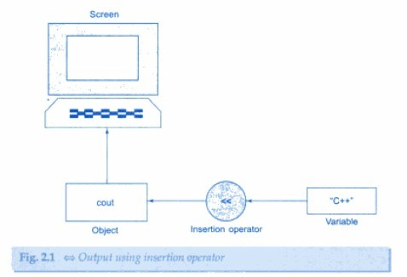
Output operator

Slide 63
Cascading of I/O Operators
The statement
Cout << “Sum = “ << sum << “\n”;
First sends the string “Sum = “ to cout and then sends the value of sum.
Finally, it sends the newline character so that the next
output will be in the new line.
The multiple use of << in one statement is called cascading.
When cascading an output operator, we should ensure
necessary blank spaces between different items.
Using the cascading technique, the last two statements can be combined as follows:
Cout << “Sum = “ << sum << “\n”
<< “Average = “ << average << “\n”;

Slide 64
Tokens
The smallest individual units in a program are known as tokens.
C++ has the following tokens
Keywords
Identifiers
Constants
Strings
operators

Slide 65
keywords
Known as reserved words
Implements specific c++ language features
Can not be used as names of identifiers

Slide 66
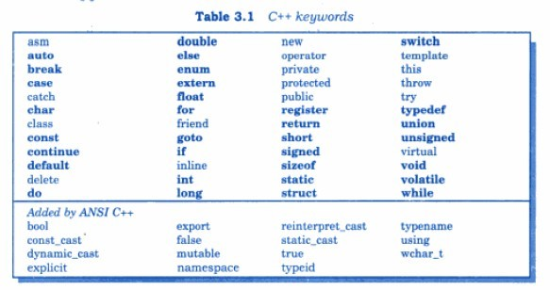
keywords

Slide 67
Identifiers
Identifiers refers to the names of variables, functions, classes etc created by the programmer.
The rules for identifiers are common in c and c+
+
It consists of a letter followed by any sequence of letters, digits, and underscores.
The name can not start with a digit.
Identifiers cannot have special characters in them
Identifiers are case-sensitive
Keywords cannot be used as identifiers

Slide 68
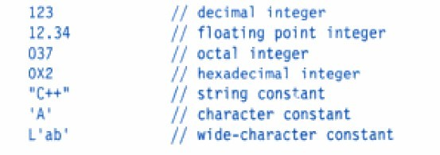
constants
Constants refer to the fixed values that do not change during execution of a program.
C++ supports integer, character, floating and string constants.
Example:

Slide 69
Strings
Object whose string type is defined in the <string> file
has a large repository of functions
char cs[ ] = “Napoleon”; // C-string
string s = “Napoleon”; // C++ - string
cout << s << “ has “ << s.length() << “ characters.\n”;
s.replace(5, 2,”ia”); //changes s to “Napolian

Slide 70
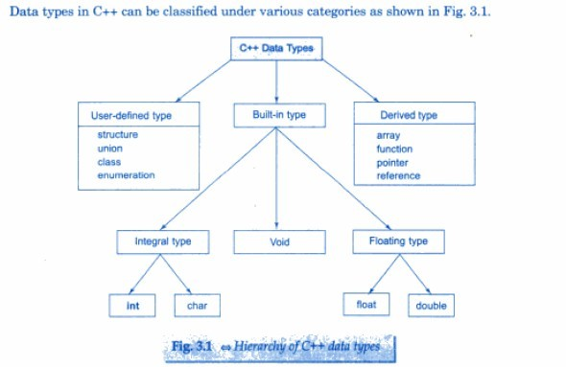
Basic Data Types

Slide 71
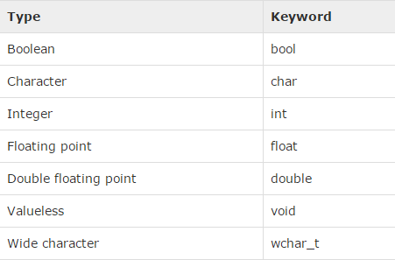
Primitive Built-in Types:
Several of the basic types can be modified using one or more of these type modifiers:
signed unsigned short long

Slide 72
Primitive Built-in Types:
Type | Typical Bit Width | Typical Range
Char or signed char | 1byte | -128 to 127
unsigned char | 1byte | 0 to 255
Int or long int or signed int or long signed int | 4bytes | -2147483648 to 2147483647
unsigned int | 4bytes | 0 to 4294967295
short int or signed short int | 2bytes | -32768 to 32767
unsigned short int | 2bytes | 0 to 65,535
unsigned long int | 4bytes | 0 to 4,294,967,295
float | 4bytes | +/- 3.4e +/- 38 (~7 digits)
double | 8bytes | +/- 1.7e +/- 308 (~15 digits)

